Slide 1
Tech Giants Financial Statements
Jacob, Delroy, and Kendell

Slide 2
Project Purpose
We analyzed the five tech giants (Apple, Amazon, Facebook, Google, and Microsoft) to compare and contrast their financial performances over the last 3 years. We web scraped their financial statements and used other resources to identify each company’s main sources of revenue, cash balance, main uses of cash, and financial ratios to help give perspective on the similar, yet different approaches each company took to successfully grow on a large scale basis. We also created an application that will graph their stock performance over that same time period (with up to 20 years worth of past performance data).

Slide 3
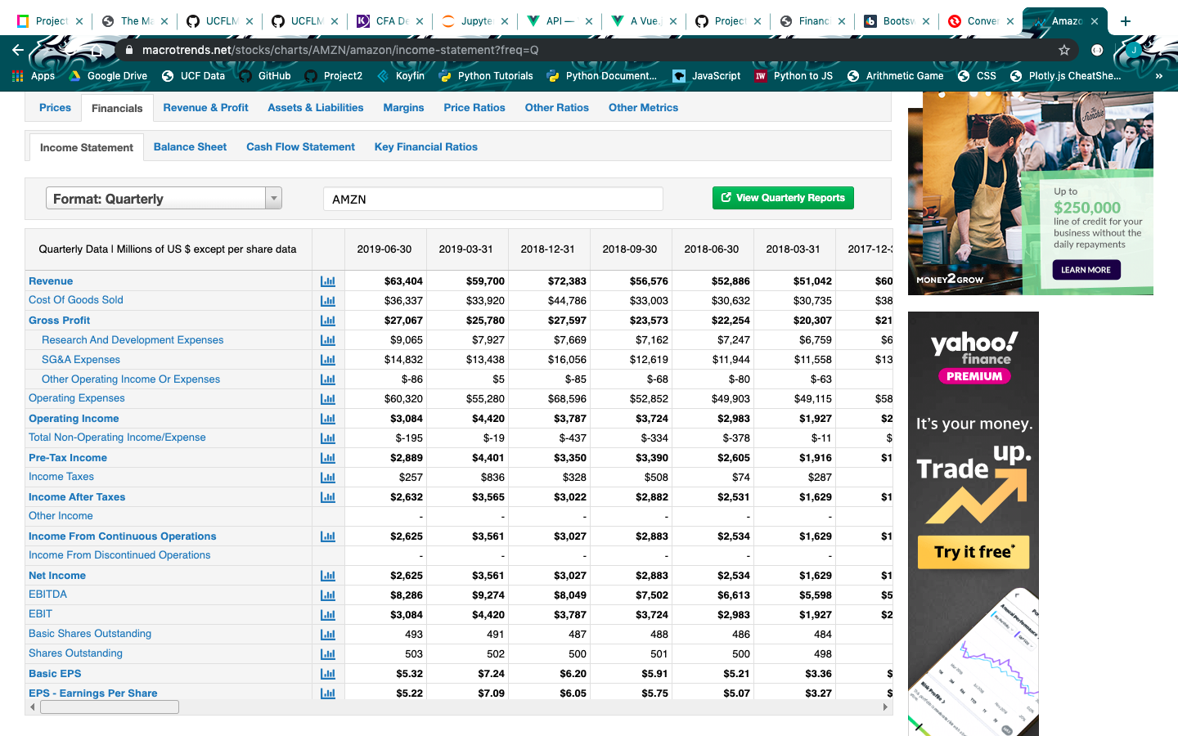
Macrotrends.net

Slide 4
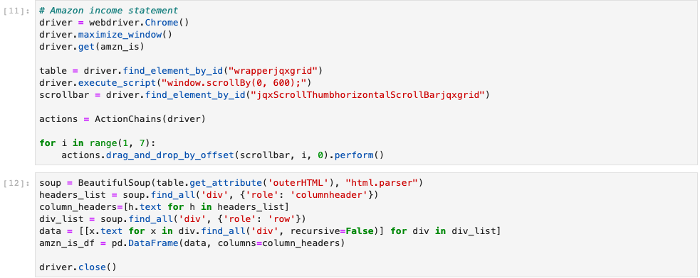
Web Scrape

Slide 5
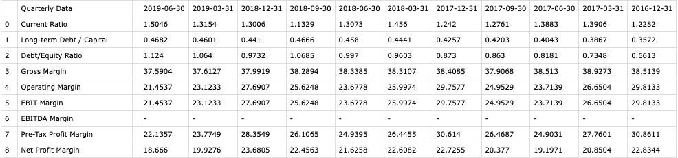
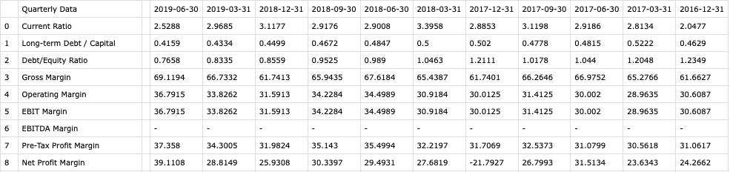
AAPL vs. MSFT

Slide 6
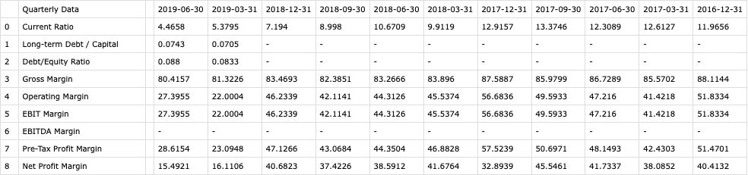
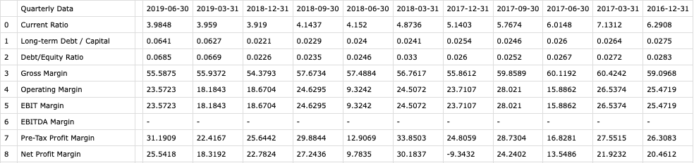
FB vs. GOOGL

Slide 7
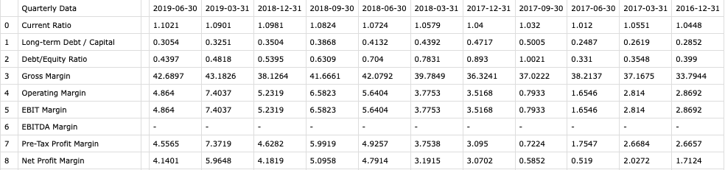
AMZN

